Slide 1
What is Data Science?
1. Data ingestion
Data science starts with collecting data from various sources using various methods, which can be structured data like customer data and unstructured data like log files, video, audio, images, IoT, social media, etc.
I still agree with this.
3. Data analysis Data scientists analyze data to identify biases, patterns, ranges, and distributions. This informs hypothesis generation and determines suitability for predictive analytics, machine learning, and deep learning models. Accurate models support decision making and drive scalability.
I still agree with this.
2. Data storage and data processing Data comes in different formats and structures, so companies choose storage systems with the help of data management teams who set standards for data storage and structure. This stage involves cleaning, deduplicating, transforming, and integrating data using ETL or other technologies to improve data quality before loading into a data repository.
I still agree with this statement, although I have mostly worked with the same data formats, such as CSV. However, I haven't had much experience with ETL, especially in the context of data science. ETL is more commonly used in Business Intelligence.
4. Communicate
Insights are presented as reports and visualizations for easier understanding by business analysts and decision-makers. Data science programming languages like R or Python include visualization components or dedicated visualization tools can be used.
I still agree with this.
Source: https://www.ibm.com/topics/data-science

Slide 2
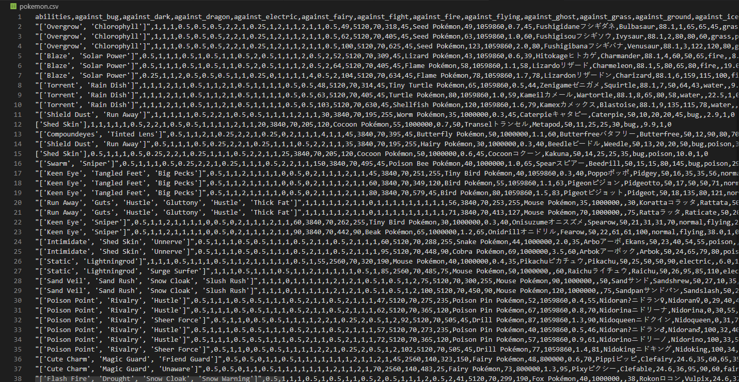
Examples Bulletpoint 1 and 2
Data ingestion
Data storage and data processing
I loaded datasets in formats such as CSV and analyzed all the Pokémon characters in Python.

Slide 3
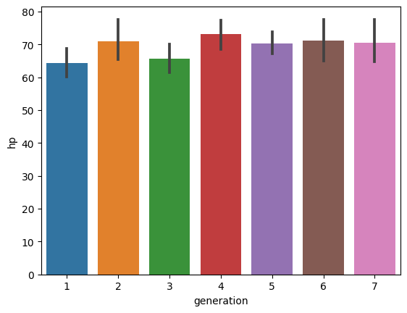
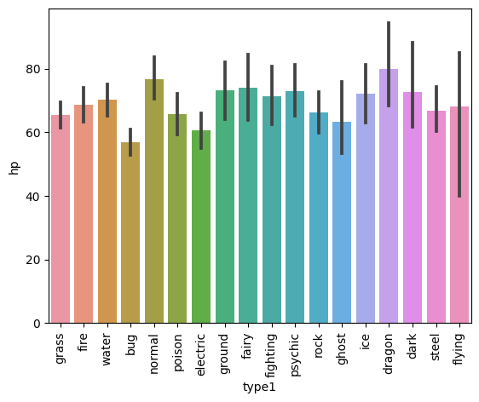
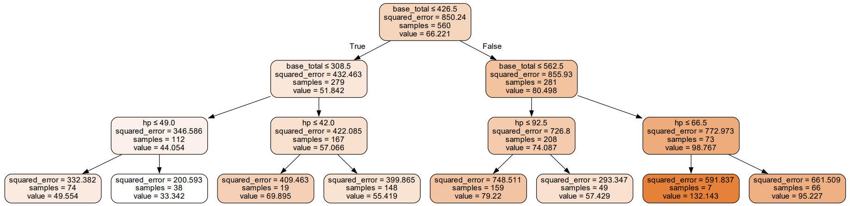
Examples Bulletpoint 3 and 4
3. Data analysis
4. Communicate
I analyzed the Pokémon dataset in Python with bar charts and decision trees.
You can use this information to make business related decisions.
The decision tree is generated based on machine learning.

